Slide 1
Cisco 8945
End User Training

Slide 2
Welcome
Instructor: Name
Schedule: One hour and fifteen minutes
  Phone Orientation
  Call Handling Features
  Voice Mail
Reference Cards
Conversion: July 9th beginning at Noon.
Cell Phone Consideration

Slide 3

Cisco 8945 IP Phone

Slide 4
Phone Orientation

Slide 5
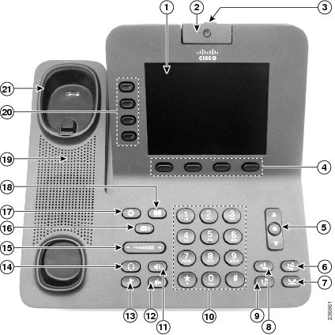
Phone Orientation

Slide 6
Call Handling Features

Slide 7
Placing Calls
To place a call:
  Lift the handset or
  Press the Speaker button or
  Press the Headset button or
  Press the New Call softkey or
  Press a line button
  Dial the number

Slide 8
Dialing
To call an extension number:
  Dial the 5-digit extension number
To call an external telephone number:
  Dial 9 + 1 + telephone number
To call Emergency Services:
  Dial 911 or 9 + 911

Slide 9
Answering Calls
To answer an incoming call:
  Lift the handset or
  Press the Speaker button or
  Press the Headset button or
  Press the Answer softkey or
  Press the flashing amber line button

Slide 10
Video Calling Features
  Camera: Center yourself in field of view
  Privacy Shutter: Blocks video from being sent
  Video Mute: Blocks video from being sent
  Note: Audio is still active
  Minimize softkey: Toggles from video mode to home screen
  Show Video softkey: Toggles from home screen to video mode
  PIP softkey: Move and remove the PIP window
  Swap softkey: Near-end/Far-end full screen toggle

Slide 11
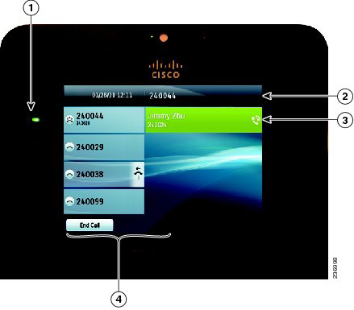
Phone Screen and Call Icons
Icon | Status
 | Line in Use
 | Line on Hold

Slide 12
Call States
Solid green: Active call.
Flashing green: Held call.
Flashing amber: Incoming call.
Solid red: Shared line in use.

Slide 13
Call Hold
To place a call on hold:
  Press the Hold button
To retrieve a held call:
  Press the Hold button or
  Press the Resume softkey or
  Press the flashing green line button

Slide 14
Placing a Second Call
To place a second call on the same line:
  Press the Hold button
  Press the New Call softkey
  Dial the number
To disconnect from second call and return to first:
  Press the End Call softkey
  Press the Resume softkey or
  Press the flashing green line button

Slide 15
Answering a Second Call
To answer a second incoming call:
  Press the flashing amber line button

Slide 16
Managing Multiple Calls
To toggle between two held calls on the same line:
  Press the flashing green line button
To toggle between three or more held calls on the same line:
  Navigate to the held call
  Press the Resume softkey

Slide 17
Ending Calls
To end a call:
  Replace the handset or
  Press the Speaker button or
  Press the Headset button or
  Press the End Call softkey

Slide 18
Shared Line Appearances
To answer a call on a shared line:
  Press the flashing amber line button
To toggle between held calls on different lines:
  Press the flashing green/red line button

Slide 19
Redial
To redial the last number called:
  Press the Redial button
To view a list of recently called numbers:
  Press the arrow down on the navigation button

Slide 20
Speed Dial
To place a speed dial call:
  While on-hook, enter the speed dial code
  Press the Speed Dial softkey

Slide 21
Call Transfer
To transfer a call:
  Press the Transfer button
  Dial the extension number or
  9 + 1 + telephone number*
  Option: Announce the caller
  Press the Transfer button or
  Transfer softkey

Slide 22
Call Transfer
If no answer or the line is busy:
  Press the End Call softkey
  Press the Resume softkey or
  Press the flashing green line button
To toggle between calls:
  Press the Swap softkey

Slide 23
Direct Call Transfer
To transfer two callers on the same line to one another:
  While connected to an active call, press the Transfer button
  Navigate to the call to transfer to
  Press the Transfer button or
  Transfer softkey

Slide 24
Call Transfer to Voice Mail
To transfer a call to a subscriber’s voice mail box:
  Press the Transfer button
  Dial * + the voice mailbox number
  Press the Transfer button or
  Transfer softkey

Slide 25
Conference Calling – Ad Hoc
To place up to an 6-way conference call:
  While connected to an active call, press the Conference button
  Dial the next participant
  Option: Announce the conference
  Press the Conference button or
  Conference softkey
To add additional participants:
  Repeat the above steps

Slide 26
Conference Calling - Join
To add an incoming caller to an existing call or conference:
  While connected to the incoming call, press the Conference button
  Navigate to the call or conference
  Press the Conference button or
  Conference softkey

Slide 27
Conference Calling - List
To view conference participants:
  Press the View Details softkey
To remove a conference participant:
  Navigate to the participant to remove
  Press the Remove softkey

Slide 28
Call Forwarding
Call Forward Busy – forwards a call on a busy condition to the line’s call coverage destination.
Call Forward No Answer – forwards a call on a ring no answer condition to the line’s call coverage destination.

Slide 29
Call Forwarding - All
To immediately forward all your incoming calls to another number:
  While on-hook, press the Forward All softkey
  Dial the 5-digit extension number or
  9 + 1 + telephone number* or
  Press the Messages button
To deactivate call forwarding:
  Press the Forward Off softkey

Slide 30
Call Divert
To immediately forward a ringing, live, or held call to voice mail:
  Press the Divert softkey

Slide 31
Do Not Disturb
To disable/re-enable the ringer for all incoming calls:
  While on-hook, press the DND softkey

Slide 32
Call PickUp*
To answer a ringing call on a call pickup group members phone:
  Go off-hook
  Press the PickUp softkey
  Press the Answer softkey
  * Assigned to lines requiring this functionality.

Slide 33
Call Park
To put a call on hold at one phone and retrieve it at another:
  Press the Park softkey
  Note: Displayed Park number: 711XX
  Hang up
To retrieve a parked call:
  Dial the park number: 711XX

Slide 34
Extension Mobility
To temporarily configure another Cisco 8945 phone as your own:
  Press the Applications button
  Select Extension Mobility
  Enter your UserID: Employee ID
  Enter your PIN: Network Password
  Press the Submit softkey
  Press the Exit softkey

Slide 35
Self Care Portal
To customize your phone with speed dials and other options:
  Enter into a web browser:
  https://10.252.220.5/ucmuser
  Enter your Username: Employee ID
  Enter your Password: Network PW
  Select Sign In

Slide 36
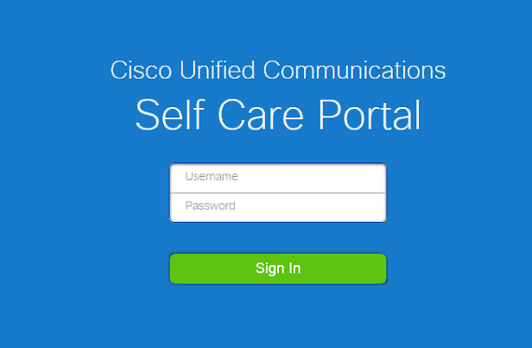

Slide 37
Voice Mail

Slide 38
Calling Voice Mail
To call Voice Mail for the first time:
  Press the Messages button
  Enter your starter PIN followed by #
Starter PIN:
1 2 3 4

Slide 39
Voice Mail Enrollment
To initialize your voice mailbox:
  Press the Messages button
  Enter the Starter PIN followed by #
  Record your First and Last Name
  Record a Personal Greeting
  Enter a PIN
  Select to keep your directory status

Slide 40
Calling Voice Mail
To call Voicemail from your desk:
  Press the Messages button
  Enter your PIN followed by #
To call Voicemail from
an outside line:
  Dial __________________
  Press *
  Enter your Mailbox ID Number followed by #
  Enter your PIN followed by #
Mailbox ID Numbers:
5-digit extension number

Slide 41
Voice Mail Main Menu
1 Play New Messages
2 To Send a Message
3 Review Old Messages
4 Setup Options
Tips:
* Exit or back-up
0 for Help
## number and spelling entry toggle

Slide 42
1 or 3 During Message Review
Repeat | Save | Delete
1 | 2 | 3
Slow | Volume | Fast
4 | 5 | 6
Back | Pause | Forward
7 | 8 | 9
Cancel | Help | End
* | 0 | #

Slide 43
1 or 3 After Message Review
Repeat | Save | Delete
1 | 2 | 3
Reply | Forward | New
4 | 5 | 6
Back |  | Properties
7 | 8 | 9
Cancel | Help | New
* | 0 | #

Slide 44
2 – Send a Message
Record your Message
Enter the extension or spell the name of the person or distribution list followed by #
Press 9 1 to add a name
Press # to send or choose from a delivery option
Delivery Options:
Mark urgent | Request return receipt | Mark private
1 | 2 | 3
Set future delivery | Review recording | Re-record message
4 | 5 | 6
Add to the message
7 | 8 | 9
Cancel | Help | Send
* | 0 | #

Slide 45
4 – Setup Options
1 - Greetings:
1 – Edit the standard greeting
2 – Turn on/off alternate greeting
3 – Edit other greetings
4 – Play all greetings
2 – Message Settings:
1 – Message notification
3 – Menu style
4 – Private lists
3 – Personal Settings:
1 – PIN
2 – Recorded name
3 – Directory listing

